Slide 1
Car Sales Dashboard Project
Complete Data Analytics Pipeline
A comprehensive journey from raw data to insightful business dashboards
Presented by
Agam Shah
August 5, 2025

Slide 2
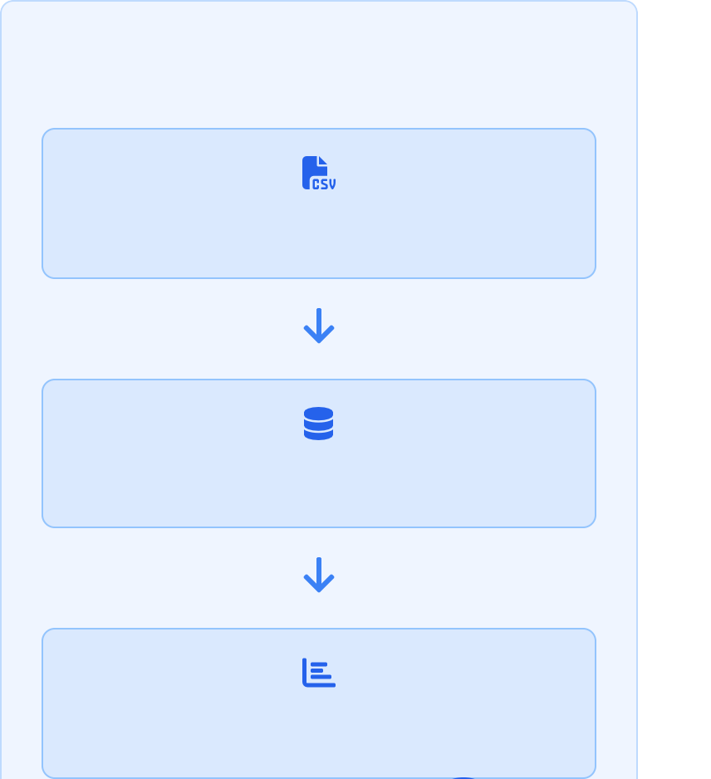


Introduction & Project Objectives
Project Overview
Project Pipeline
Complete Analytics Pipeline: A comprehensive solution that transforms raw car sales data into actionable business insights through automated
processes
Raw Data Sources
Purpose: Provide real-time visibility into sales performance, inventory trends, and dealer profitability across multiple dimensions
Key Objectives:
Enable data-driven decision making for sales and inventory Track dealer performance with standardized KPIs
Identify sales trends and opportunities through interactive visuals Automate data processing for reliable, consistent reporting
ETL Processing
Dashboard Insights

Slide 3
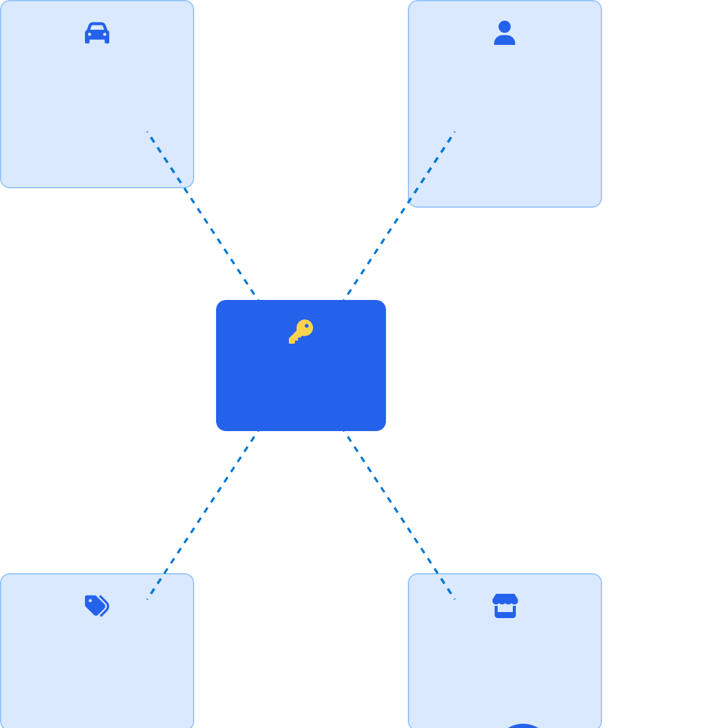




Data Sources & Overview
Car Model Specs
make, model, year, fuel_type, seats...
Ownership Info
num_owners, used_KMs, ownership_years...
Primary Datasets
Car Model Specs
Contains detailed vehicle specifications including make, model, year, engine type, transmission, body style, seating capacity, and fuel type.
Ownership Info
Records of vehicle ownership history including number of previous owners, ownership duration, and vehicle usage metrics (e.g., mileage).
car_id
Primary Key
Sales Info
Transaction details including sale date, sale price, list price, discount applied, profit margin, and location of sale.
car_id
Primary Key
Seller Info
Dealer/seller details including dealer ID, name, location, rating, sales volume, and specialization.
Sales Info
sale_date, price, discount, location...
Seller Info
dealer_id, rating, sales_volume...

Slide 4





Data Modeling & Key Columns
Key Data Elements
Primary Key
car_id: Unique identifier that ensures consistent joins across all tables and prevents duplicate entries.
Schema Design
Uses a star schema with a central fact table (Sales) connected to dimension tables (Cars, Owners, Dealers) through the common car_id.
Secondary Columns
Essential fields for analysis including engine_size, seats, model_type, num_owners, last_service_date, insurance_status, accident_history, location, brand, model_year, model, price, discounted_price, used_KMs, buying_date, buying_price, dealer_name, dealer_rating and seller_type.
Cars
Sales
Dealers
Derived Columns
Calculated fields that add analytical value:
Year, month, day, quarter, day of week derived from date
Fuel Type derived from model
Weekend Indicates if a date falls on a weekend.
Is discount indicating whether discount applied or not
Final price calculated from price and discount price
Data Modeling Benefits
Optimized for both analytical queries and dashboard performance
Ensures data consistency across reporting views Facilitates easy maintenance and future extensibility

Slide 5




Data Quality Report: Inconsistencies & Null Values & Outliers
Identified Issues & Solutions
Inconsistent Formatting
Inconsistent capitalization and formatting in key categorical fields for example, Fuel_Type ("diesel" vs "Diesel" vs "DIESEL").
Before & After Data Cleaning
Original Data | Cleaned Data | Method
Cng, CNG | Cng | Standardization
AUTOMATIC | automatic | Standardization
[NULL] | dealer | Median Imputation
Petrolmanual | manual | Category Mapping
[NULL] | 3.8 | Mean Imputation
Missing Values
Critical null values columns across datasets.
Contradict Values
Mismatch of values in derive column from column which it actually derived.
Finding Outliers
Using Box plots visualize data distribution and easily identify outliers that fall outside

Slide 6




Data Ingestion: From CSV to MSSQL
Import Process
1 Select Source File
Approach
Loading raw CSV files into Microsoft SQL Server using the SSMS Import Flat File Wizard - a streamlined solution for bringing structured data into our database.
File Path:
C:\Data\car_sales.csv
Format: CSV
Browse...
Import Steps
Right-click database in SSMS and select Import Flat File
Select source CSV file and specify destination table name Preview data and verify field mappings
Customize column data types and nullability if needed Execute import and verify results
2 Preview Data
car_id | make | model | year | price
1001 | Toyota | Camry | 2019 | 24999
1002 | Honda | Accord | 2020 | 27850
3 Modify Columns
Common Issues
Data type mismatches - Especially with dates and numeric fields
Text truncation - When string data exceeds defined column length
Encoding issues - Special characters not properly recognized
car_id
int
make
nvarchar(50)
price
Import Successful

Slide 7


Automated Data Pipeline with Python & Apache Airflow
ETL Pipeline Automation
Airflow DAGs
Directed Acyclic Graphs define workflow tasks and dependencies, ensuring proper execution sequence for our car sales data pipeline.
ETL Process
Extract: Source CSV files from multiple systems Transform: Clean data, standardize formats Load: Store in clean MSSQL tables
Key Benefits
Scheduling: Automatic daily data refreshes Monitoring: Real-time pipeline status alerts Reproducibility: Consistent data processing
Error handling: Automatic retries and notifications
Python Integration
Custom Python scripts handle complex transformations like fuel type normalization, outlier detection, and derived calculations.

Slide 8
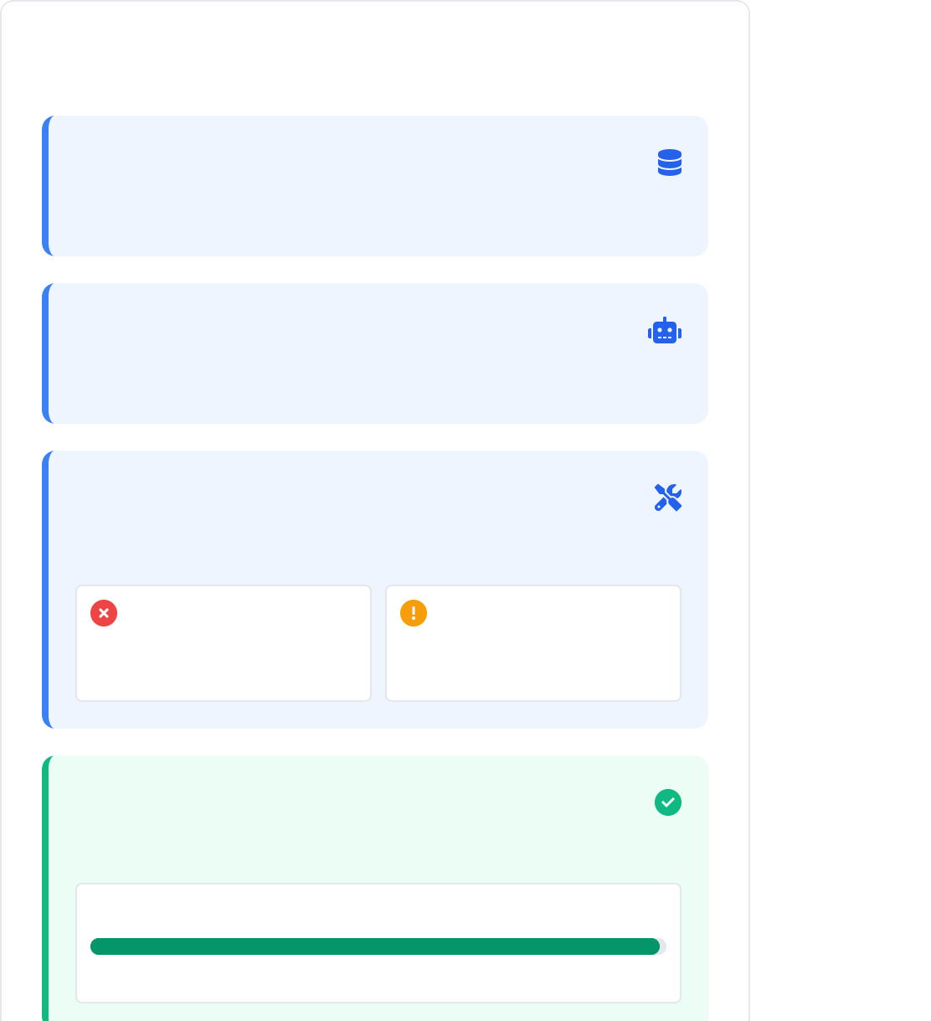


Data Loading Validation
Data Validation Workflow
Validation Process & Checks
1. Initial Data Load
Raw data transferred to staging tables
Manual MSSQL Validation
Direct database queries to verify record counts, data types, and key field integrity across tables after ETL completion.
2. Automated Validation
DAG runs schema & constraint checks
DAG Query Checks
Automated validation steps built into Apache Airflow DAGs to ensure data quality requirements are met before completing the workflow.
3. Issue Resolution
Review and resolve detected issues
String → Float error Fixed with data cleansing
Column mismatch
Renamed in transformation
Common Issues Resolved
Data type conversion errors (string to numeric) Column name mismatches between source and target Truncated values exceeding field length limits Inconsistent date formats requiring standardization
4. Final Verification
Clean data ready for dashboard use
Validation Status:
SUCCESSFUL
0%
98.7%

Slide 9
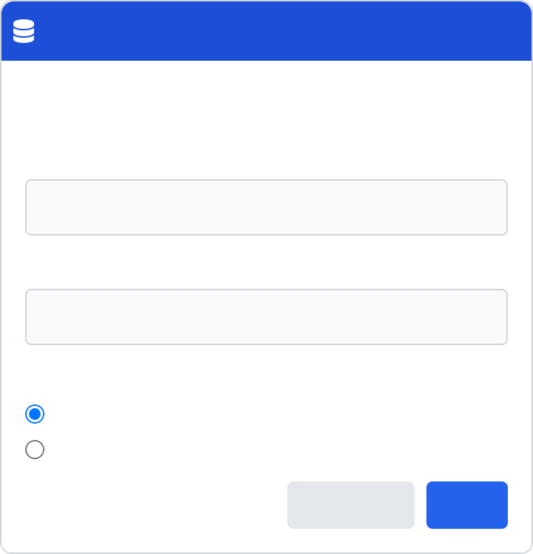
Connecting to Power BI & Data Modeling
Integration Process
1 Connect to SQL Server
Open Power BI Desktop and select Get Data > SQL Server. Enter server name and database credentials to establish connection with the cleaned MSSQL database.
Get Data
□ ×
SQL Server Database
Server
2 Import Tables
Select the cleaned tables from the Navigator window.
Choose Import mode for robust analytics capabilities with full Power BI feature support.
SQLSERVER01
Database
CarSalesDB
Data Connectivity mode Import
DirectQuery
3 Establish Relationships
Use Model view to create relationships between tables
using the car_id primary key. Create star schema with fact and dimension tables for optimal performance.
Car_Specs
OK
4 Configure Refresh
Set up on-premises data gateway to enable scheduled refreshes. Configure authentication and refresh frequency to keep dashboard data current.

Slide 10




Dashboard Overview: Sections & Navigation
Main Dashboard Sections
Sales Tab
Primary sales metrics, location-based sales performance, and temporal analysis of sales trends over time.
States Tab
highlights the monetary details of sales, such as cost, profit, and discount, usually categorized by place and brand..
Car Specs Tab
Technical vehicle specifications analysis including fuel type, seating capacity, and performance metrics.
Overview Tab
Comprehensive data tables with detailed records.
Interactive Filter Controls
All dashboard tabs feature consistent filter panels that allow users to drill down by date, location, make/model, and dealer.
Clear All Filters One-click filter reset available on all tabs

Slide 11
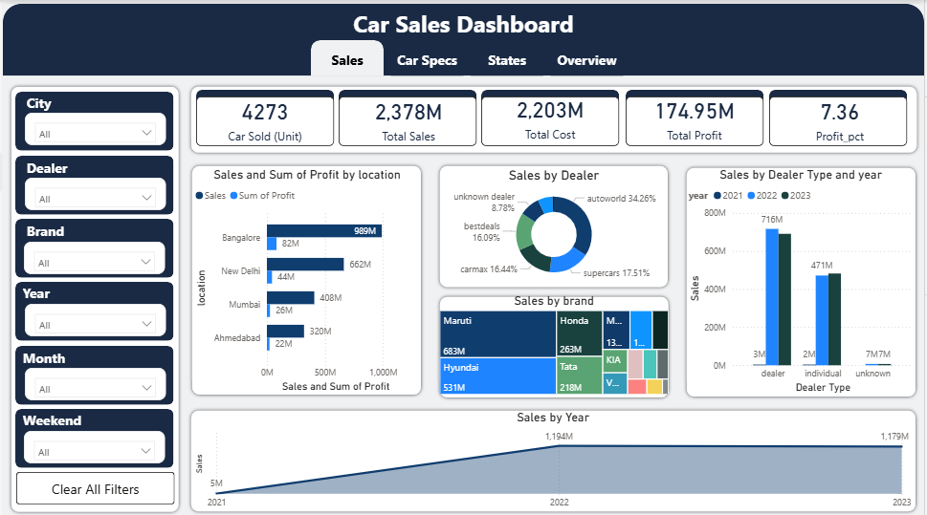
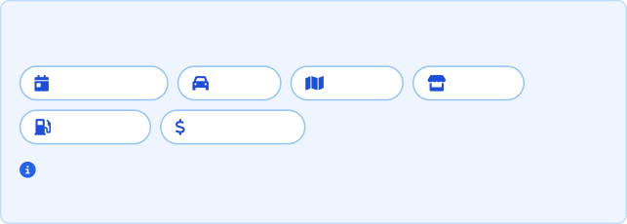
Deep Dive: Sales Tab
Key Sales Metrics & Features
Total Sales Performance
Year-over-year comparison with target achievement indicators and quarterly breakdown.
Sales by Location
Interactive map visualization with region-specific performance metrics and drill-down capabilities.
Sales by Dealer
Top-performing dealers with volume metrics, efficiency ratings, and comparative analysis.
Temporal Analysis
Trend lines showing seasonal patterns, monthly growth rates, and year-over-year performance.
Key Sales Tab Insights
Enables executive-level performance oversight with KPI cards showing
Interactive Filter Options
Date Range Brand
Fuel Type Price Range
Sales petern
Region
Dealer
Identifies top-performing regions and dealers for strategic resource allocation
Reveals seasonal sales patterns to optimize inventory and marketing
initiatives
All metrics automatically update when filters are applied, enabling deep cross-dimensional analysis.
Supports strategic decision-making through interactive filters for multidimensional analysis
Made with Genspark

Slide 12
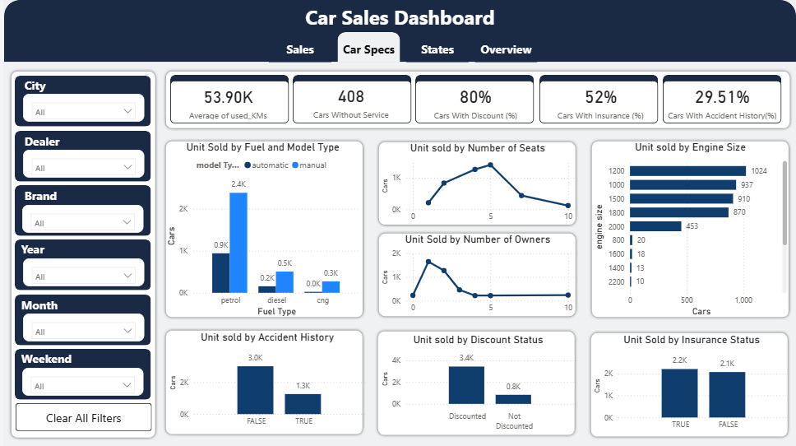



Deep Dive: Car Specs Tab
Key Metrics & Insights
Fuel Type Analysis
Petrol cars are selling more irrespective of car model type.
Seating Capacity Trends
5-seater models are the preference of the most of the customers buying cars, so we can make stock of more 5 seater cars in the store to get more sales.
Accident history
Car without accident have more sales then cars with accident so we can buy more cars which do not have accident history rather than buying cars with accident history.
Key car specs Tab Insights
Enables executive-level performance oversight with KPI cards showing
Sales pattern
Identifies customer preference for specs for strategic resource allocation
Reveals sales patterns for cars of different fuel type
Supports strategic decision-making through interactive filters for multidimensional analysis

Slide 13
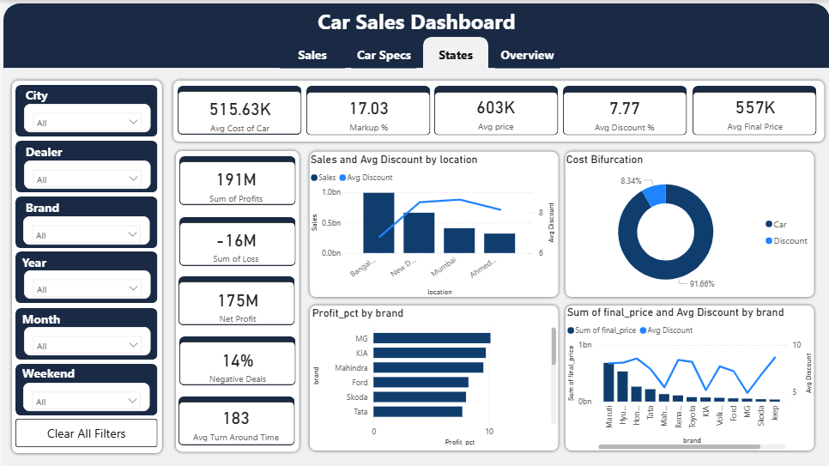
Deep Dive: States Tab
Key State-Level Metrics
Avg Cost
Markup %
State-level average vehicle cost with regional comparison benchmarks.
Percentage markup by state with high/low highlighting for quick insights.
Total Profit
Discount
Cumulative profit by location with avg discount indicators.
Average discount percentage by state with seasonal patterns.

Slide 14



Dashboard Design & User Experience
Design Principles
Professional Theme
Consistent corporate blue color scheme with complementary accent colors for data categories. Custom branded elements maintain company identity throughout.
Visual Consistency
Uniform chart types, consistent axis scales, and standardized data point representation. Common visual language maintained across all dashboard tabs.
Clear KPI Visualization
Prominent KPI cards placed at the top of each section with large, legible metrics. Color-coded indicators show performance trends at a glance.
Intuitive Navigation
Tab-based interface with clear labeling and logical information hierarchy. Interactive tooltips provide detailed information on hover.

Slide 15
Questions & Further Discussion
Thank you for your attention. I welcome your questions and feedback.

